Slide 1
Ethiopian Public Health Institute (EPHI)
PHEM DHIS2 End-User Manual
VI. Report

Slide 2
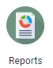
Report

Slide 3
Reports App
Reports APP session Overview
Overview of the Reports App
Data Set Reports
Reporting Rate Summary
Resources
Organization Unit Distribution Report

Slide 4
Reports App
Overview of the Reports App
The reporting App in DHIS2 provides a range of reporting alternatives, and this section will explain how to use them to view and analyze data.
The reports app allows for standard reports, data set reports, resources, and org unit distribution reports.

Slide 5
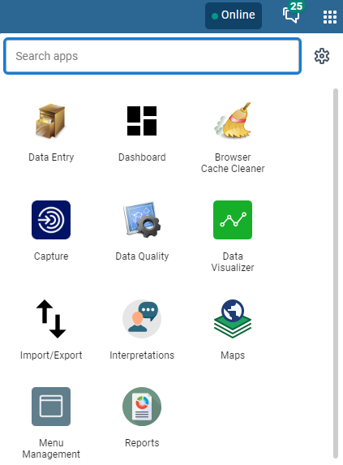
Reports App
Steps for getting the report App:
Click on the App menu at the right corner
Search for the Report App from the list of Apps
Click on Reports App
Reports

Slide 6
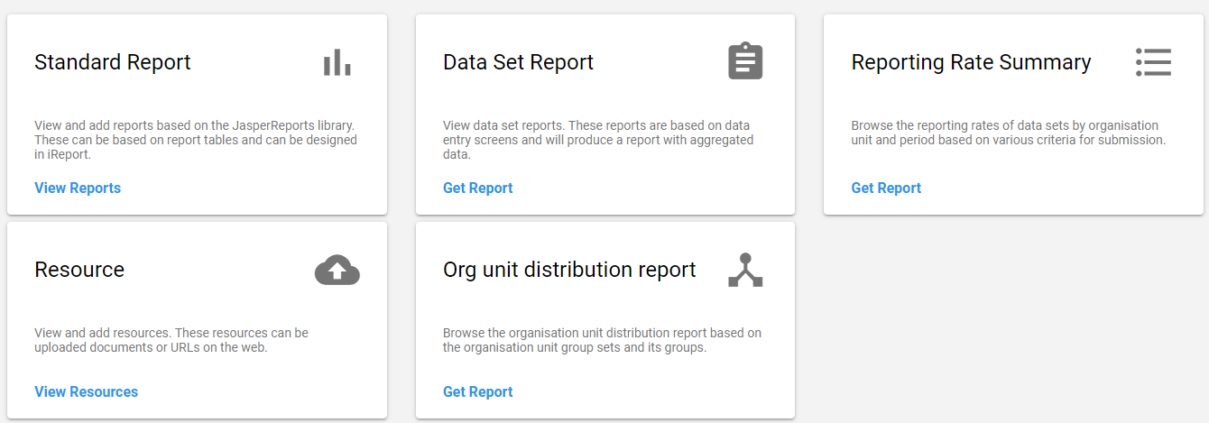
Reports App
After you open the Reports App, you will get the below menu of reports you can select from

Slide 7
Data Set Report
Dataset reports are printer friendly views of the data entry screen filled with either raw or aggregated data.
You can access data set reports from Apps → Reports.
A Criteria window will appear where you fill in the details for your report:
  Report Organization unit: the orgunits you want the report for.
  Dataset: The data set you want to display.
  Report period: The actual period you want data for.
Notes:
Here you select the orgunit you want the report for. This can be at any level in the hierarchy as the data will be aggregated up to this level automatically (if you do not tick the option above).
Report period: The actual period you want data for. This can be aggregated as well as raw periods. This means that you can ask for a quarterly or annual report even though the data set is collected monthly. A data set's period type (collection frequency) is defined in data set maintenance. First select the period type (Monthly, Quarterly, Yearly etc.) in the drop down next to Prev and Next buttons, and then select one of the available periods from the dropdown list below. Use Prev and Next to jump one year back or forward.

Slide 8
Data Set Report
To run the report, you can follow these steps:
Go to Apps → Reports Apps → Data Set Report
1
3
2

Slide 9
Data Set Report
To run the report, you can follow these steps:
Go to Apps → Reports Apps → Data Set Report
Select the desired Organization Unit
Select the desired Data set
Select the Period type (weekly, monthly, etc.) and insert the specific period of interest
Click on Get report

Slide 10
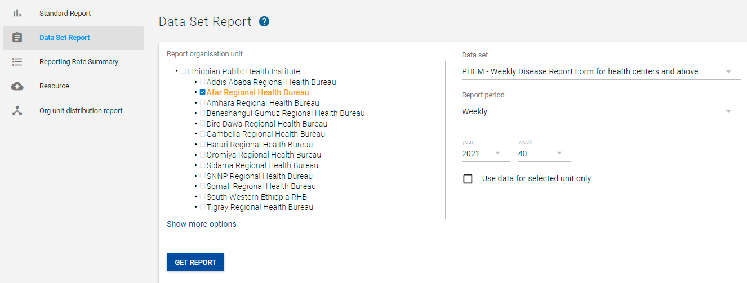
Data Set Report
To run the report, you can follow these steps:
2
1
3
4
5

Slide 11
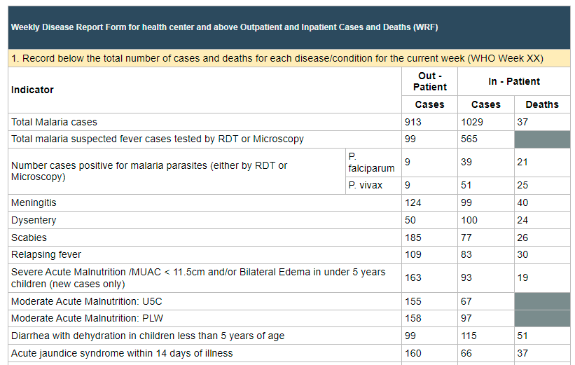
Data Set Report
Change any of the parameters above and click "Get report" again see the corresponding results
1
2
3
4
5

Slide 12
Reports App
After you open the Reports App, you will get the below menu of reports you can select from

Slide 13
Reporting Rate Summary
Reporting rate summaries will show how many datasets (forms) that have been submitted by organization unit and period.
A complete data set registration refers to a user marking a data entry form as complete, typically by clicking the complete button in the data entry screen, hereby indicating to the system that he/she considers the form to be complete.

Slide 14
Reporting Rate Summary
The reporting rate summary will for each row show a range of measures:
Actual reports: Indicates the number of data entry complete registrations for the relevant data set.
Expected reports: Indicates how many data entry complete registrations are expected. This number is based on the number of organization units the relevant data set has been assigned to (enabled for data entry).
Reporting rate: The number of actual reports registered as complete divided by the number of expected reports as a percentage.

Slide 15
Reporting Rate Summary
Reports on time: Differs from actual reports in that it only counts reports registered as complete within the maximum number of days after the end of the reporting period. This number of days after reporting period can be defined per data set in the data set management.
Reporting rate on time: The number of reports on time divided by the total expected number of reports as a percentage

Slide 16
Using reporting rate summary
To run the report, you can follow these steps:
Select Report Rate Summary
Select an organization unit from the tree.
Select a data set.
Select a period type and a period from the list of available periods for that period type.
The report will then be rendered. Change any of the parameters above and click "Get report" again see the corresponding results.

Slide 17
Reporting Rate Summary
To run the report, you can follow these steps:
Select Report Rate Summary
Select an organization unit from the tree.
Select a data set.
Select a period type and a period from the list of available periods for that period type.
Click on “Get report” and the report will then be rendered. Change any of the parameters above and click "Get report" again see the corresponding results.

Slide 18
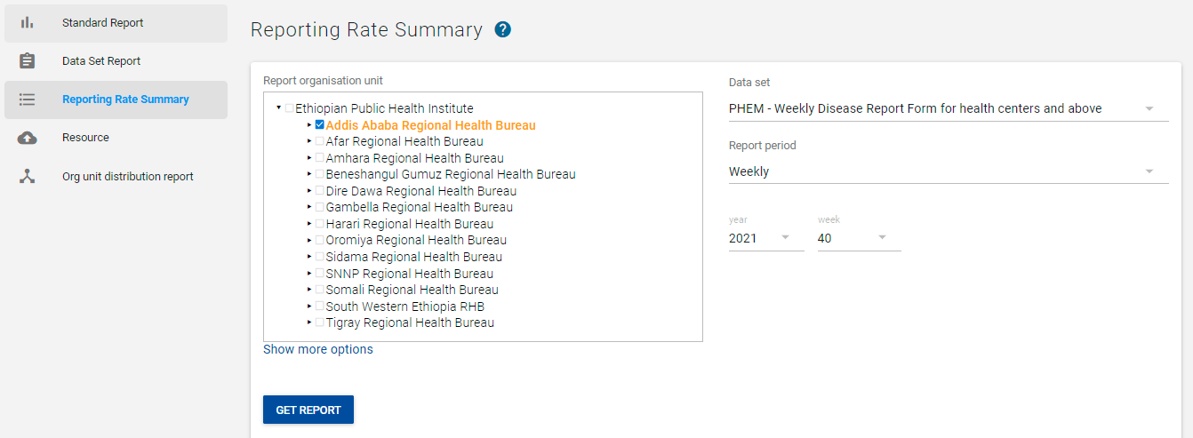
Reporting Rate Summary
1
3
2
4
5
6

Slide 19
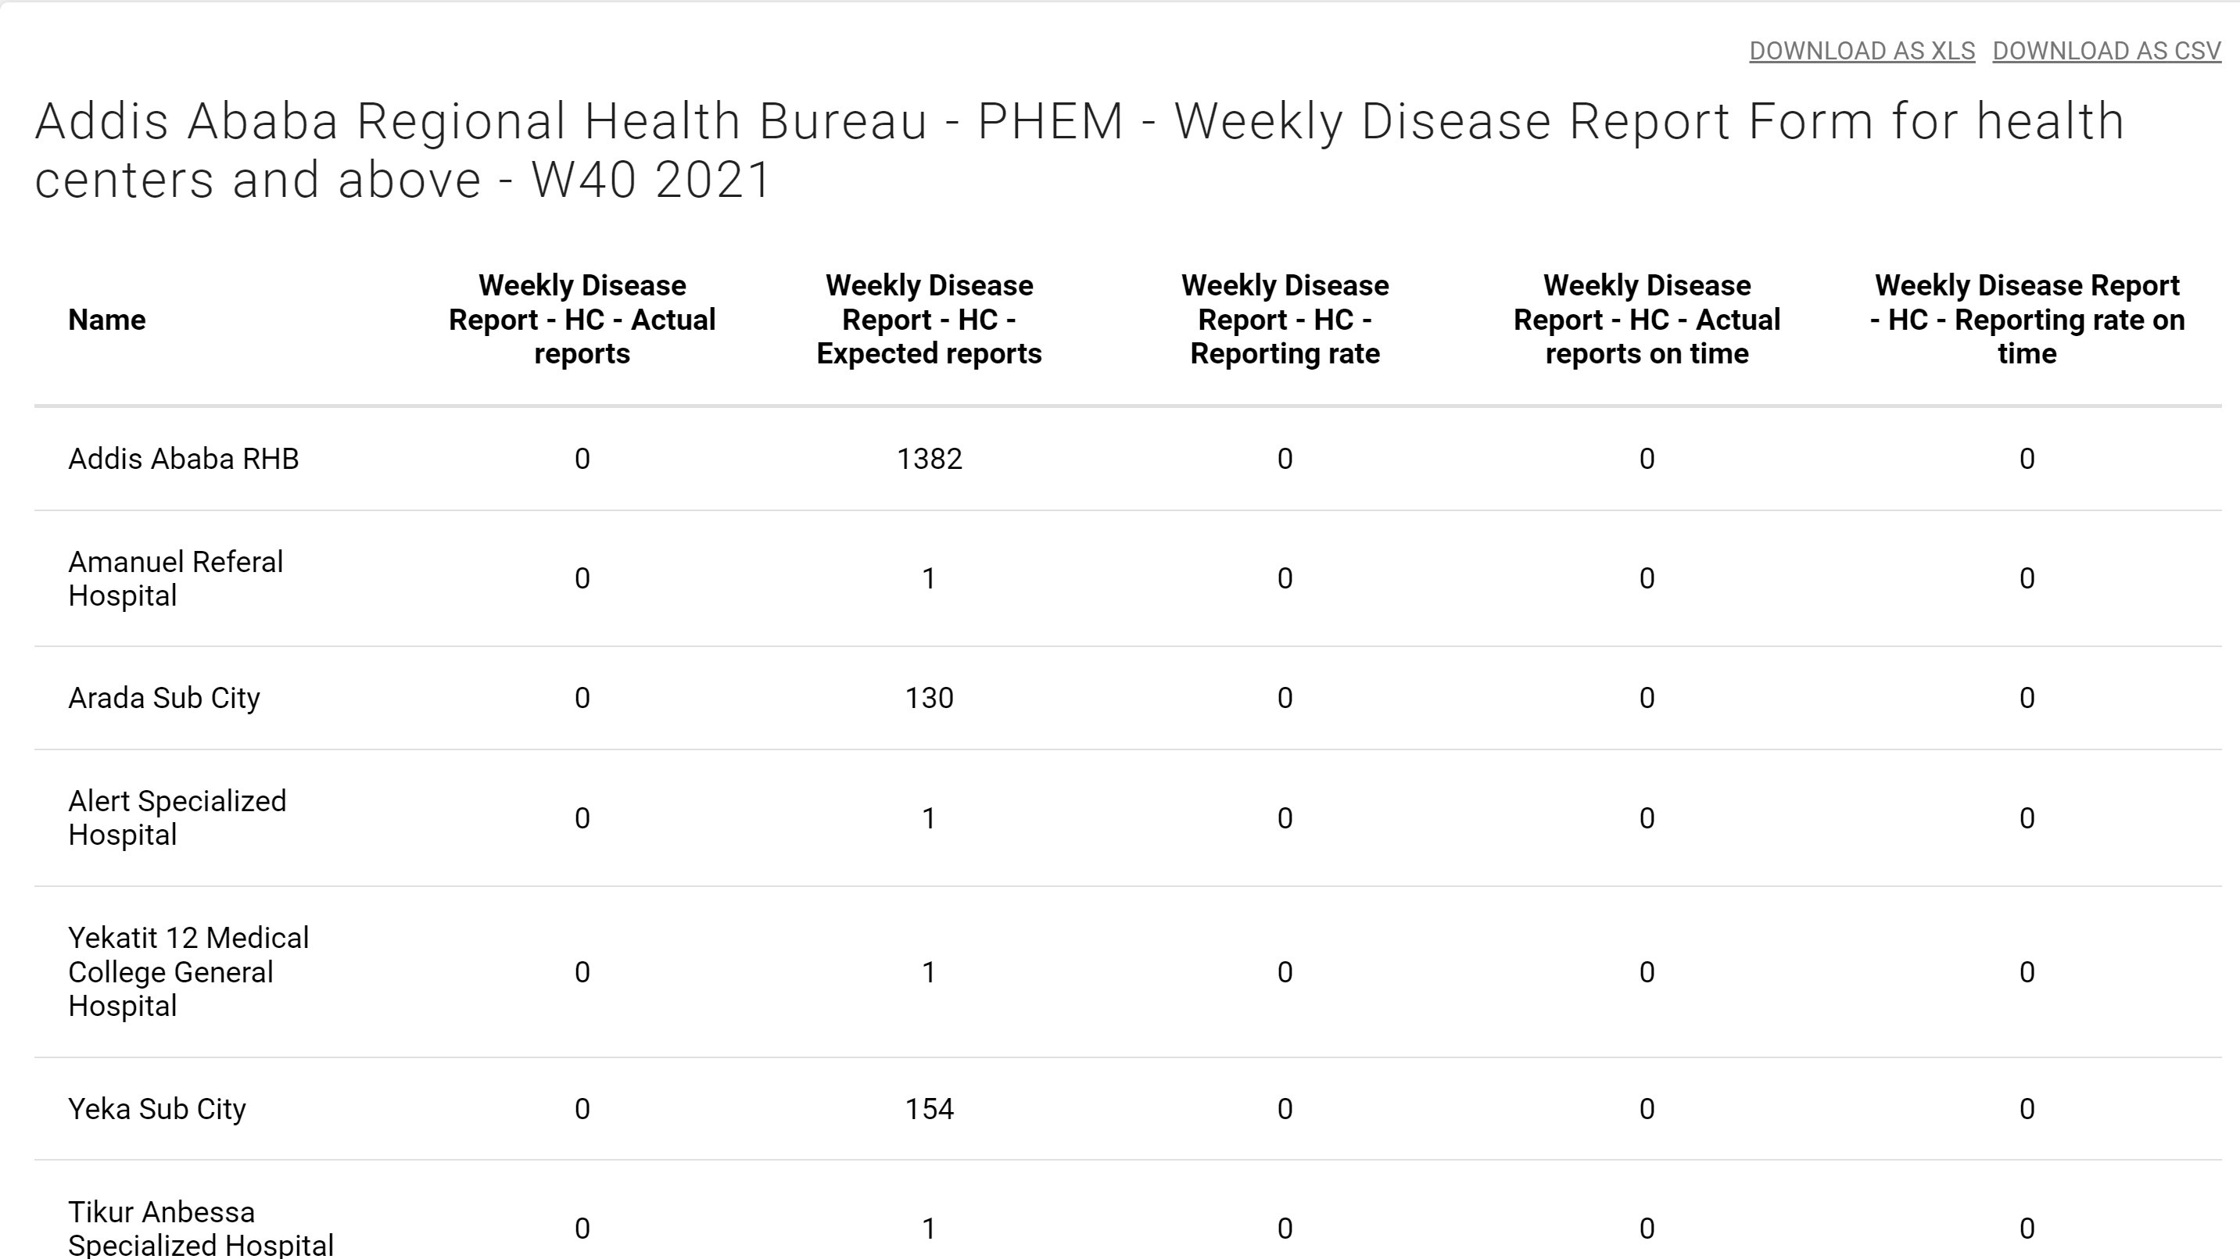
Reporting Rate Summary
  Change any of the parameters above and click "Get report" you can see the corresponding results.
You can download the table in excel or csv format

Slide 20
Reports App
After you open the Reports App, you will get the below menu of reports you can select from

Slide 21
Using resources
The resource tool allows you to upload both files from your local computer to the DHIS server and to add links to other resources on the internet through URLs.
If cloud storage is configured for your system, resources will be saved there.
Steps to create a resource to share:

Slide 22
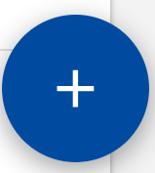
Resources
Steps to add a new resource:
Open the Reports app and click on Resource.
Click on the blue plus sign on the right bottom corner to add a new resource
Enter a Name
Select a Type
Depending on the resource type, either Upload file or External URL.
Click Save.

Slide 23
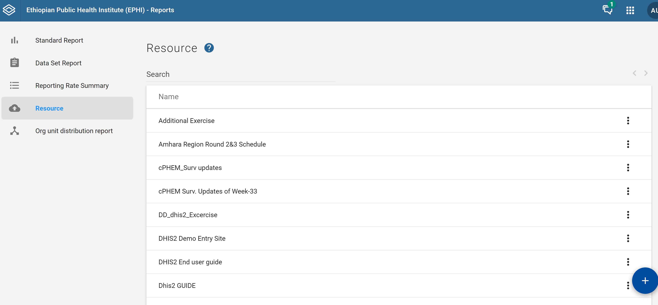
Resources
1

Slide 24
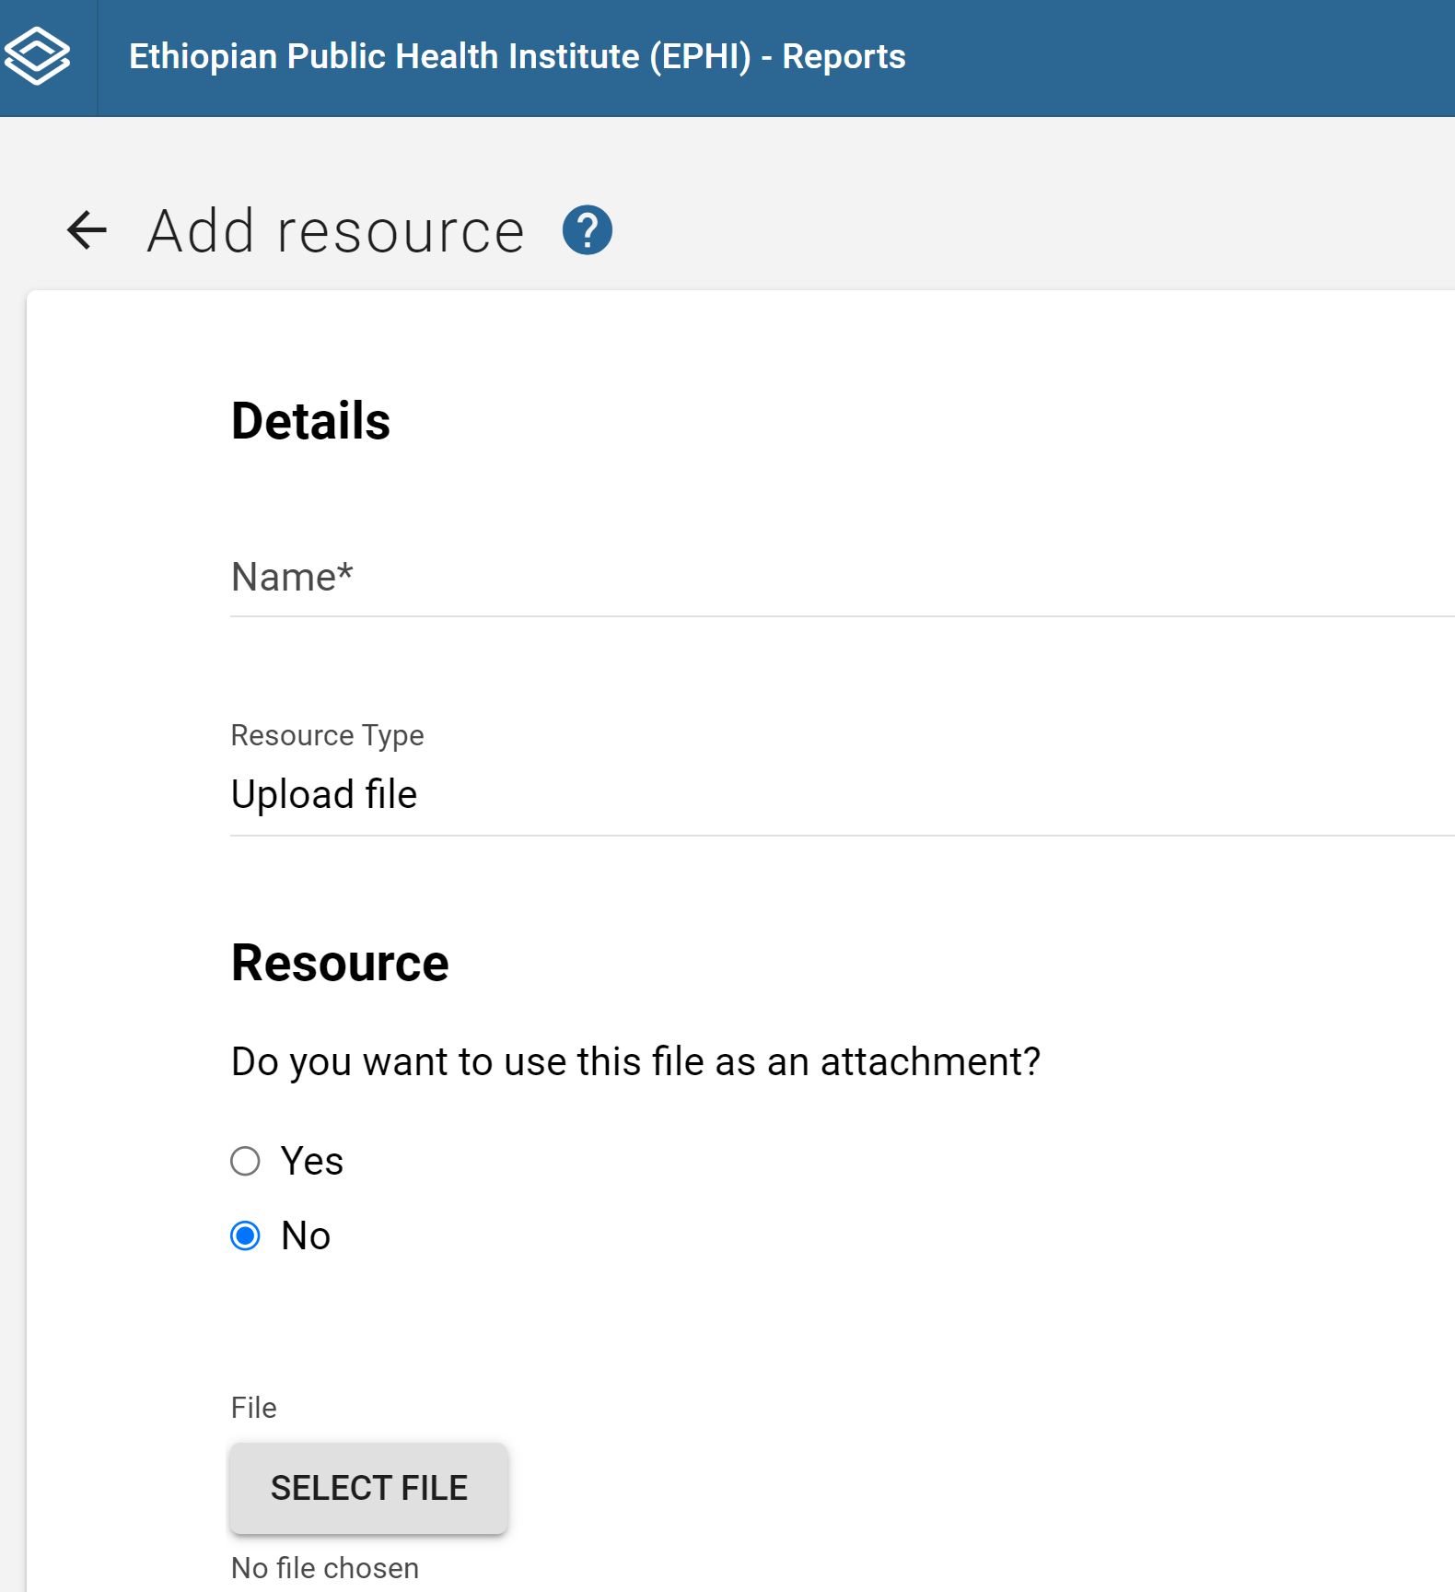
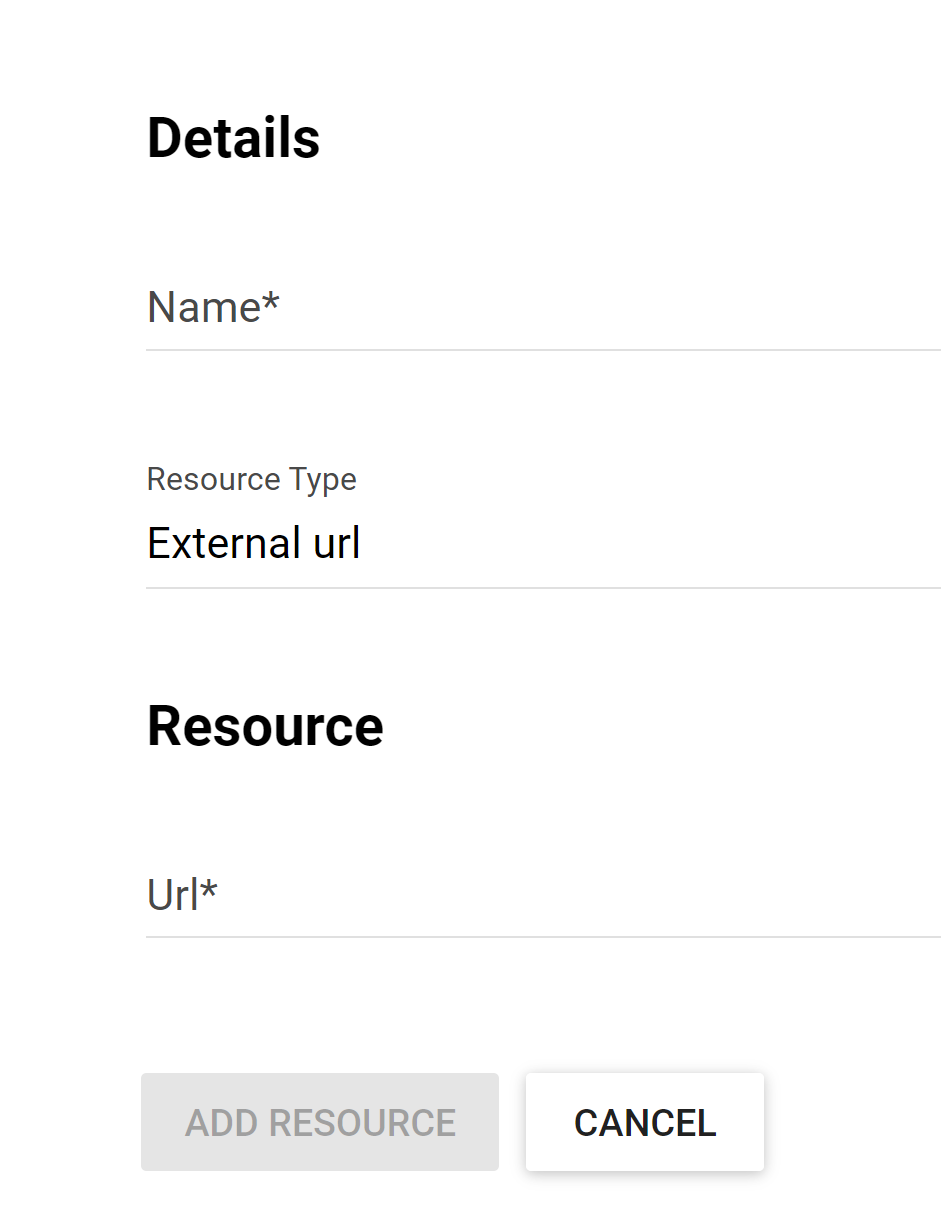
Resources
If the selected “Resource Type” is URL, then the URL link must be entered
2
3
4

Slide 25
Reports App
After you open the Reports App, you will get the below menu of reports you can select from

Slide 26
Using organization unit distribution reports
Organization unit distribution reports are reports that show how the org units are distributed on various properties like type and ownership, and by geographical areas.
The result can be presented in a table-based report or in a chart

Slide 27
Organization Unit Distribution Reports
Steps to run organization distribution report
Click on Organization Unit Distribution Report from Reports app.
Select desired report organization unit. The report will be based on the org units located under the selected org unit.
Select the group set that you want to use, typically these are Type, Ownership, Rural/Urban, but can be any user-defined org unit group set.
Click on either “Get Report” to get the table-based presentation or “Get chart” to get the same result in a chart.

Slide 28
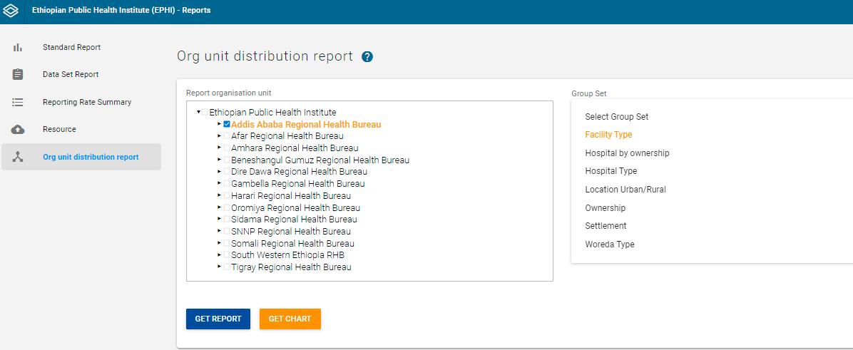
Organization Unit Distribution Reports
2
3
1
4

Slide 29
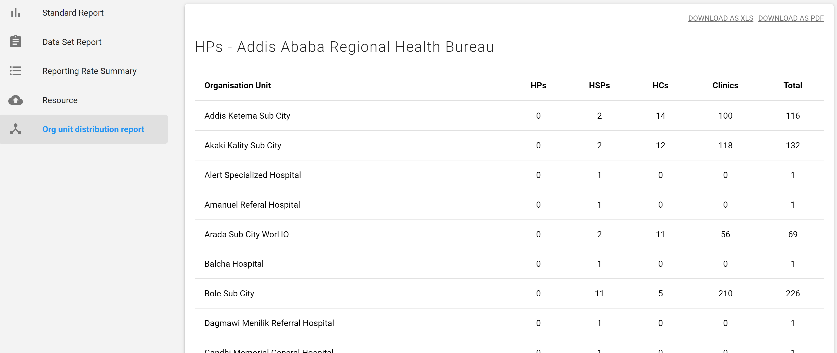
Organization Unit Distribution Reports
You can download the table in excel or pdf format

Slide 30
Thank you

